Slide 1
Figures

Slide 2
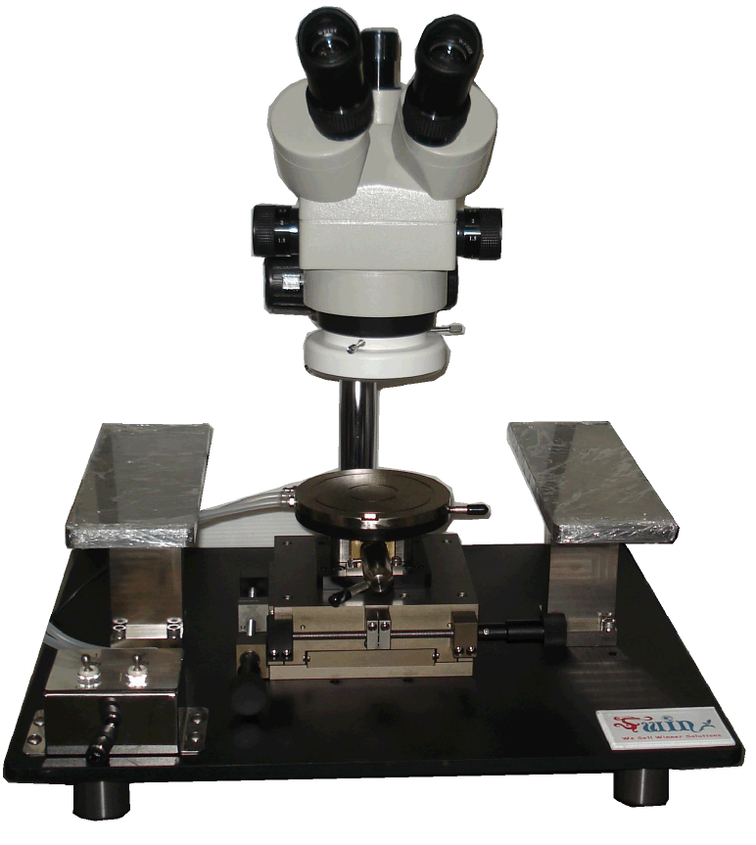
Probe Station
Chuck

